Slide 1
PAYMENTS
THE STATE OF
IN AUSTRALIA
Ben Cull
@benjii22
ssw.com.au

Slide 2
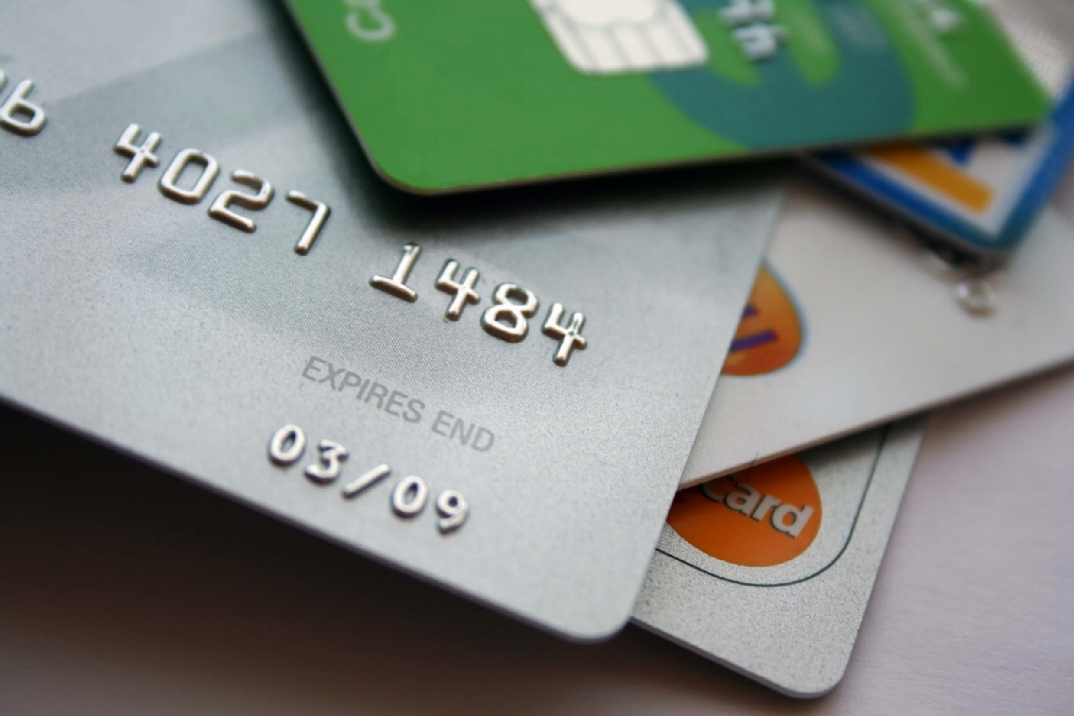
Credit Cards

Slide 3
50% Shop Online
→ June 2013 – Roy Morgan Research

Slide 4
merchant account

← Available from most banks
← Cheaper than Payment Processors
← Still need to comply with PCI

Slide 5
pci compliance
PCI Tips
← It applies to everyone Want to accept VISA or Mastercard? I thought so.
← Yes, even the small guys If your server so much as glances at a credit card number, you’re liable.
← You can avoid it Just never directly accept a credit card number

Slide 6
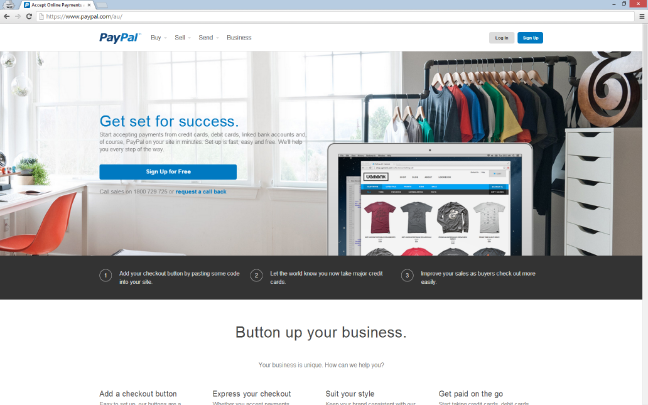
PayPal
2.4% + 30c /transaction
Too many APIs
REST API is OK
→ https://www.paypal.com/au/

Slide 7
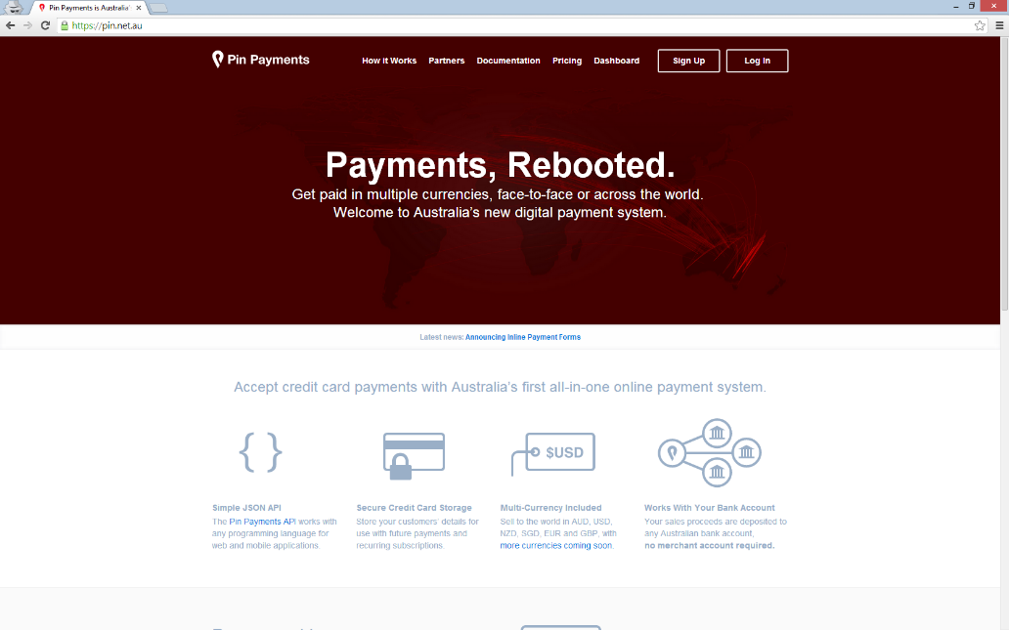
Pin Payments
3.0% + 30c /transaction
Nice REST API
Recurring Billing
Australia Focused
→ https://pin.net.au

Slide 8
Ben  stripe

Slide 9
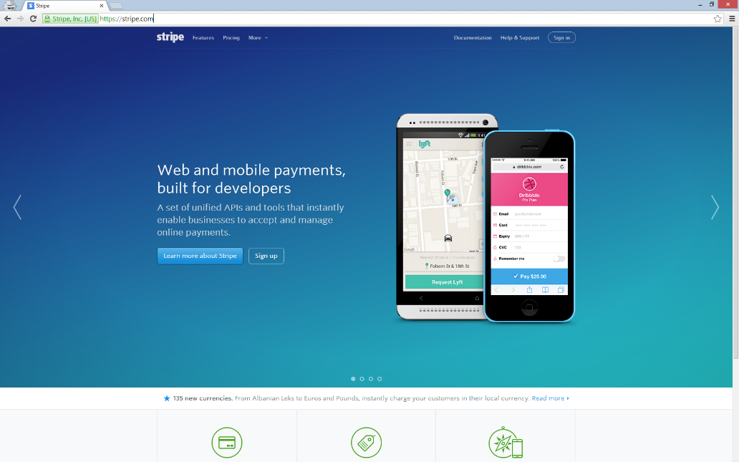
Stripe
2.7% + 30c /transaction
The Best REST API
Recurring Billing
Coupons
Stripe Checkout
Stripe Connect
Stripe Marketplace
→ https://stripe.com

Slide 10
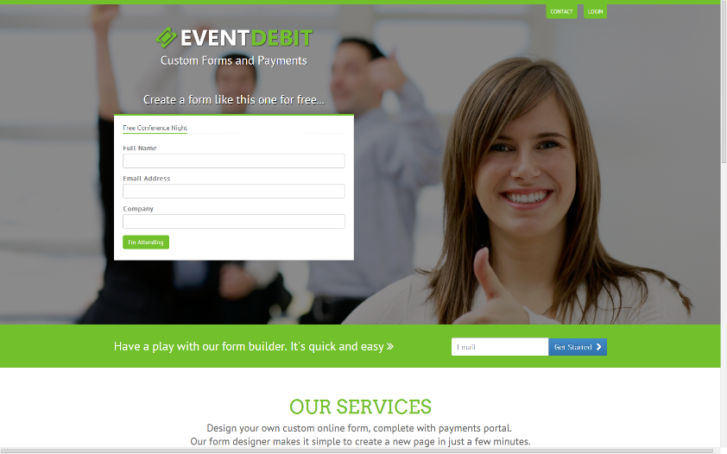
Custom Forms and Payments
https://EventDebit.com
Signup for Australian Stripe Account
Shameless Plug
Thank you
@benjii22

